Slide 1
CHAPTER 2
LIMITS AND CONTINUITY

Slide 2
CONTENTS
2.1. The Tangent & Velocity Problems
2.2. The Limit of a Function
2.3. Calculating Limits using the Limit Law
2.4. Continuity
2.5. Limits involving Infinity
2.6. Limits of Sequences

Slide 3
2.5. LIMITS INVOLVING INFINITY
2.5.1. Infinite Limits
2.5.2. Limits at Infinity
2.5.3. Infinite Limits at Infinity

Slide 4
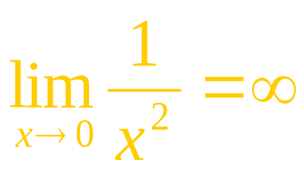
2.2.1 Infinite Limits
x
±1.0 | 1
± 0.5 | 4
± 0.2 | 25
± 0.1 | 100
± 0.05 | 400
± 0.01 | 10,000
± 0.001 | 1,000,000
The table on the right show
that as x approaches 0, becomes very large.
Thus its values do not approach any number, i.e.
does not exist.
However we can write

Slide 5
In general we have
Definition 1. We say that the limit of a function f(x) is infinity as x approaches a if
we can make the values of f(x) arbitrarily large (as large as we like)
by taking x to be sufficiently close to a but not equal to a. We also write
We also say f(x) becomes infinite as x approaches a

Slide 6
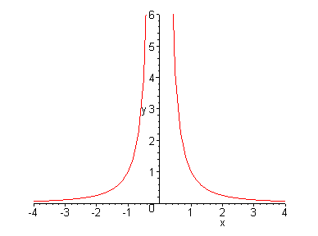
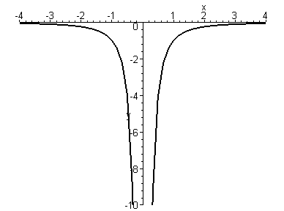
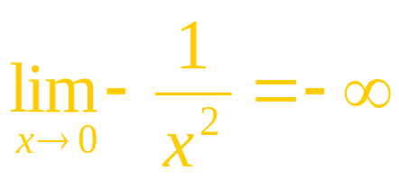
The graph of the function appears as follows
On the other hand if we graph the function
we see that –f(x) becomes very large as x approaches 0. Therefore we can write

Slide 7
In general we have
Definition 2. We say that the limit of a function f(x) is negative infinity as x approaches a if
Similarly we can define one-sided infinite limits:

Slide 8
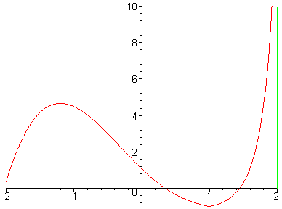
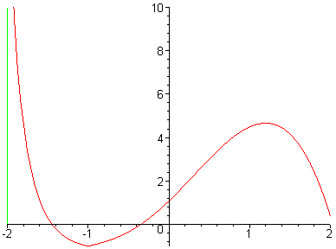
Example.

Slide 9
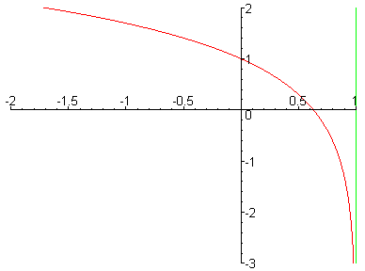
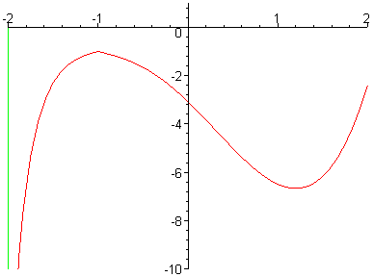
Example.

Slide 10
Definition 3. The line x = a is called the vertical asymptote of the curve y = f(x) if one of the following statements is true

Slide 11
Example. Find
Solution. As x approaches 3 but > 3, x–3 is an arbitrarily small positive number, and 2x is very close to 6.
Hence
is an arbitrarily large number.
Therefore
Similarly we have

Slide 12
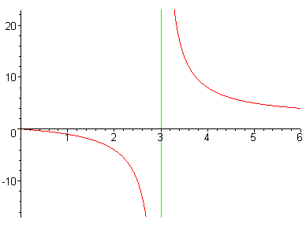
The line x = 3 is a vertical asymptote of the graph of the function

Slide 13
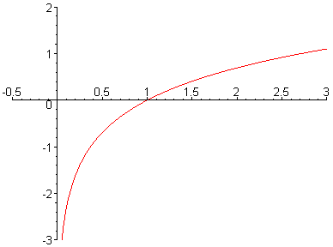
The line x = 0 is the vertical asymptote of the graph of the function f(x) = ln x since

Slide 14
As x approaches π/2 but < π/2 , cos x is an arbitrarily small positive number, and sin x is very close to 1. Hence.
So the line x = π/2 is a vertical asymptote.
similarly
So the line x = –π/2 is a vertical asymptote.
More generally the lines x = (2n + 1)π/2 , n ∈ Z, are vertical asymptotes of y = tan x

Slide 15
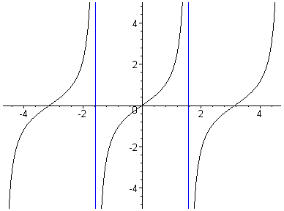
The vertical asymptotes of the graph of the function f(x) = tan x

Slide 16
Example. Find
Solution. We introduce the new variable t =tan²x
Then t → 0 as x → 0 because tan x is a continuous function.
Moreover t > 0. Hence

Slide 17
2.5.2 Limits at Infinity
In computing infinite limits, x approaches a number and the values of y becomes very large.
Now we let x become very large and see what happens to y.
Let
x | f(x)
0 | -1
±1 | 0
±2 | 0.600000
±3 | 0.800000
±4 | 0.882353
±5 | 0.923077
±10 | 0.980198
±50 | 0.999200
±100 | 0.999800
±1000 | 0.999998
It seems that as ⎮x⎮ becomes large, then f(x) approaches 1

Slide 18
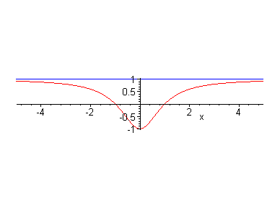
We may write

Slide 19
In general we have
Definition 4. Let f be a function defined on some interval (a, ∞). Then we say that the limit of f(x) is L as x approaches infinity if
the values of f(x) can be made as close to L as we like
by taking x sufficiently large. We also write
Similarly we can define :

Slide 20
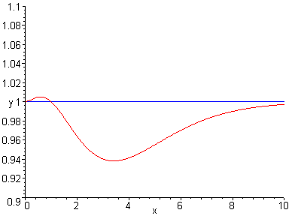
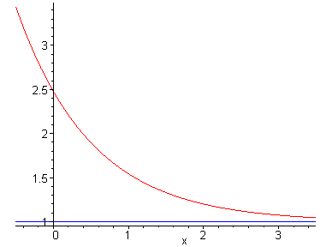
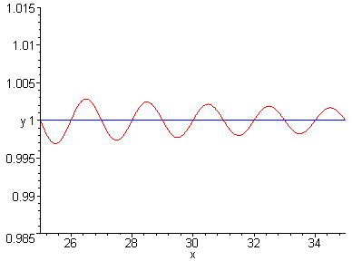
The graph of y = f(x) may approach the line y = L in many ways

Slide 21
From the graph of the function
We may write

Slide 22
Definition 5. The line y = L is called a horizontal asymptote of the curve y = f(x) if either
Example. The line y = 1 is a horizontal asymptote of the
curve

Slide 23
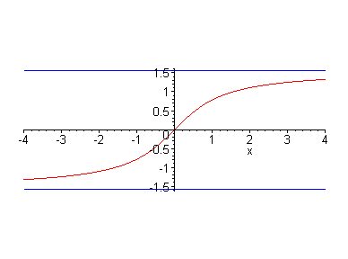
Example. The curve y = tan⁻¹x has two horizontal asymptotes y = -π/2 and y = π/2 because

Slide 24
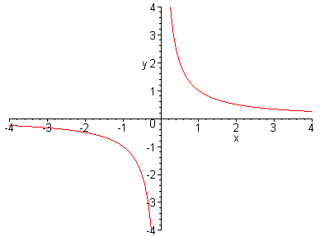
Example. Find
Solution. By taking x large enough, we can make
as close to 0 as we like. Therefore
The line y = 0 is a horizontal asymptote of the curve

Slide 25
Most of the Limit Laws (except Law 9 and Law 10) in section 2.3 also hold for limits at infinity if “x → a” is replaced by “x → ∞”
Theorem 7. If n is a positive integer, then

Slide 26
Limit Laws.

Slide 27
Example. evaluate
Solution. We have

Slide 28
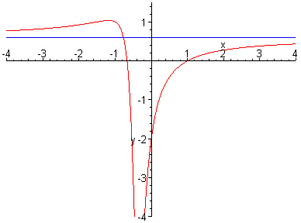
By a similar computation, we have
The line y = 0.6 is a horizontal asymptote of the curve

Slide 29
Example. evaluate
Solution. We have

Slide 30
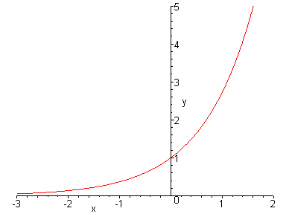
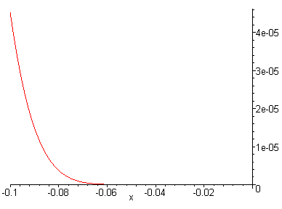
Theorem 8.
Proof
Example. evaluate
Solution. Let t=1/x, then
t→-∞ as x →0⁻ . Hence

Slide 31
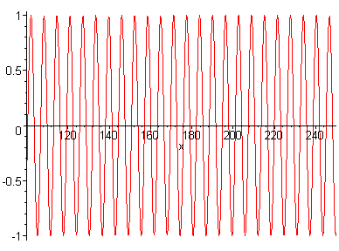
Example. evaluate
Solution. As x increases, the values of sin x oscillate between –1 and 1 infinitely often. Thus
does not exist

Slide 32
2.5.3 Infinite Limits at Infinity
We write
if the values of f(x) can be made arbitrarily large as x becomes sufficiently large. Similarly we may define
We have

Slide 33
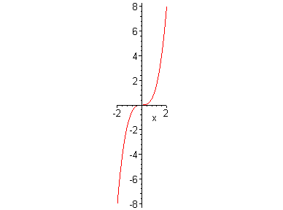
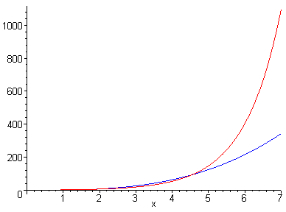
The function y = e^{x} increases to ∞ as x becomes large much faster than the function y = x³

Slide 34
Example. evaluate
Solution. We cannot write
This is an indeterminate form. However we have

Slide 35
Example. evaluate
Solution. We have

